Slide 1
JavaScript – Part II
Chapter 5
CSF3206

Slide 2
Learning Outcomes
Describe the use of Object in JavaScript.
How to create and use an Object?
Explain core JavaScript’s object.
Creating user defined JavaScript’s object.
Applying the concept of Document Object Model (DOM).
User JavaScript to redirect to other page.

Slide 3
JavaScript Objects
Almost everything in JavaScript is an object; E.g. String, Array, Date, Windows, buttons, form, etc.
Properties
Objects
Methods

Slide 4
What is an object?
A way of modeling something real,
even though the object is an
abstract entity

Slide 5
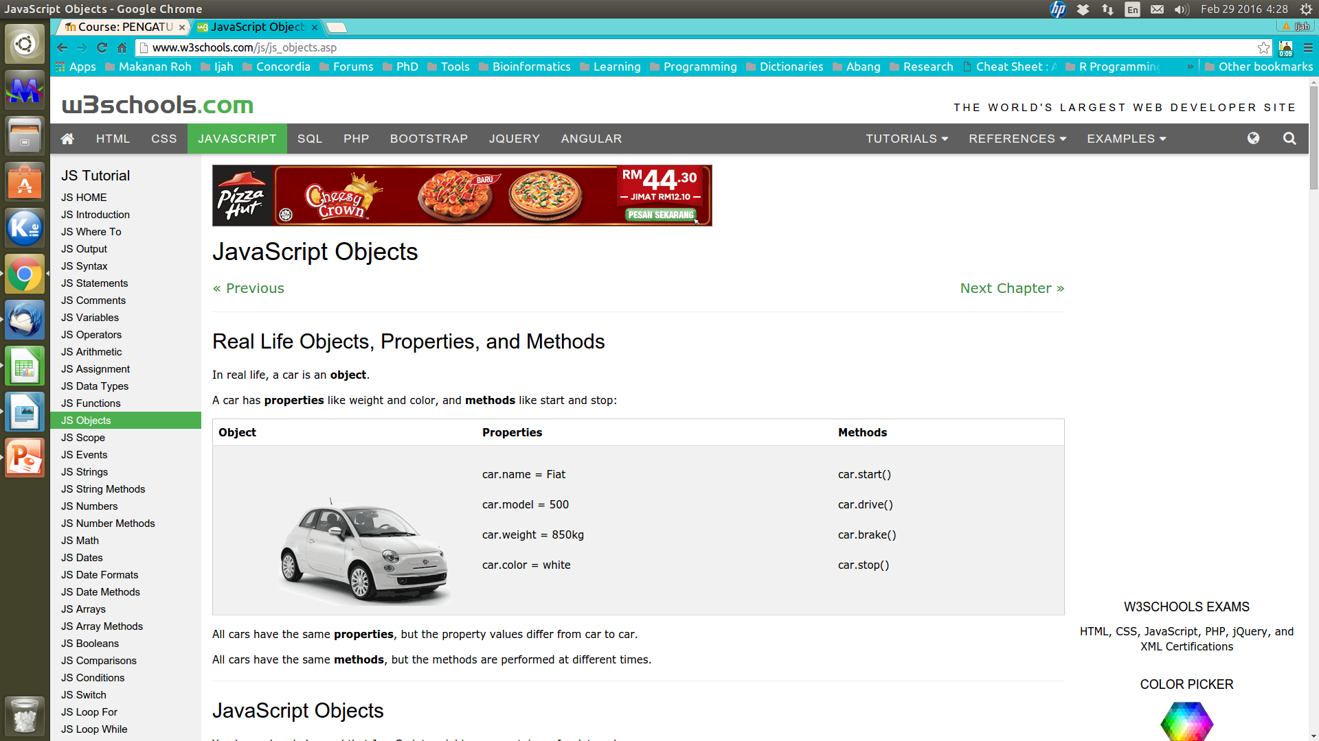

Slide 6
Objects in JavaScript
Object provide a flexible way for JavaScript scripting.
JavaScript objects - basically a collection of properties and values, (known as a hash table in programming).
In JavaScript, objects are data (variables), with properties and methods.
Example; Creating JavaScript String object.
var mySubject = new String(“CSF3203”);
Object | Property | Method
“CSF3203” | mySubject.length | mySubject.indexOf(“CSF”)

Slide 7
4 groups of objects in JavaScript:-
User-defined objects
Custom objects by programmer
Built-in objects
Provided by JavaScript itself
Browser objects
Objects not specified by as part of JavaScript language but most browsers support
Document objects
Objects that are part of DOM. They present the programmer with a structured interface to HTML and XML documents

Slide 8
Why are objects useful?
They give programmer another way to organize things within a script
How?
Group similar variables together under an object

Slide 9
How to Create An Object?
Purpose – to interact with user.
Object
Constructor
Creating JavaScript Object
object literal notation

Slide 10
Creating an Object
ISBN
Author
Book
Title
Publisher

Slide 11
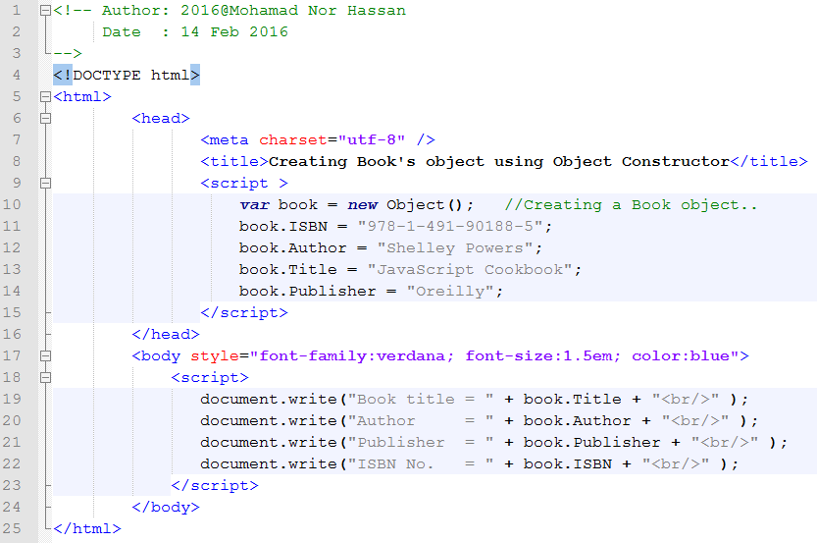
Creating Object using Object Constructor
Assign properties and values

Slide 12
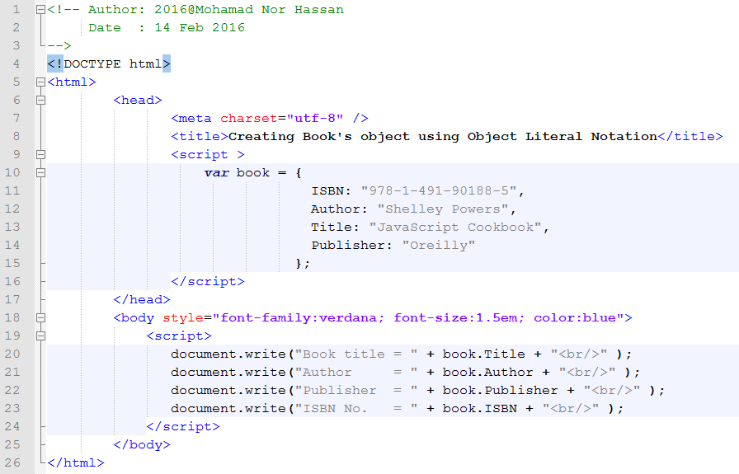
Creating Object using Object Literal Notation
Assign properties and values

Slide 13
Constructor Functions
Can be used to create a reusable code for an object.
E.g. create Customer object.
Can be used for different customer (credit customer, cash customer, etc) that having same property & method names.

Slide 14
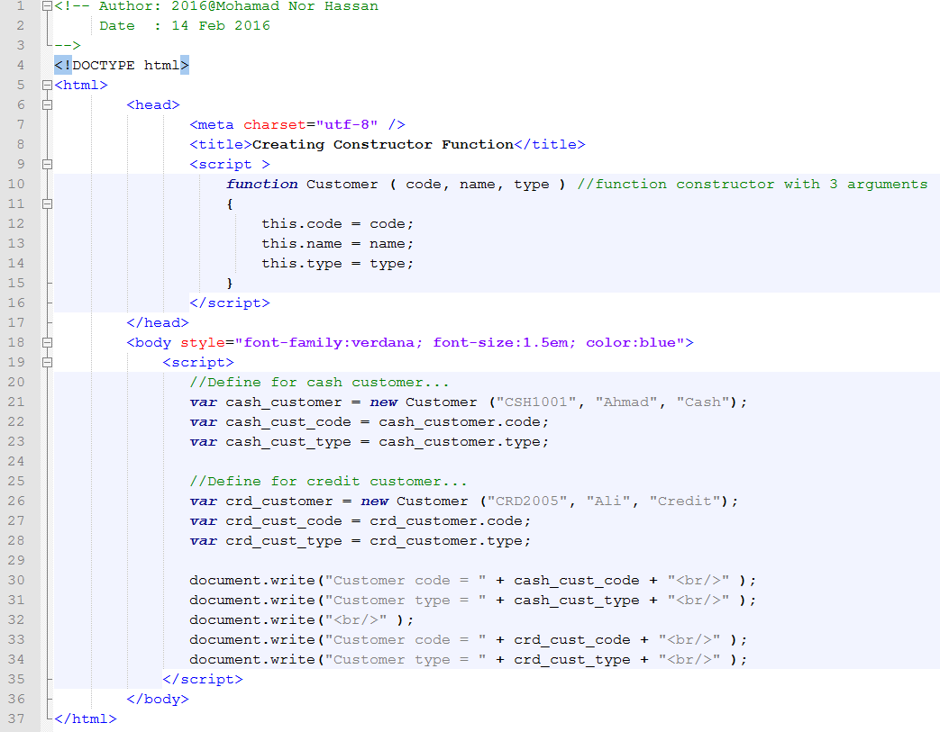
Constructor Functions
Create new instance of object
Create new instance of object

Slide 15
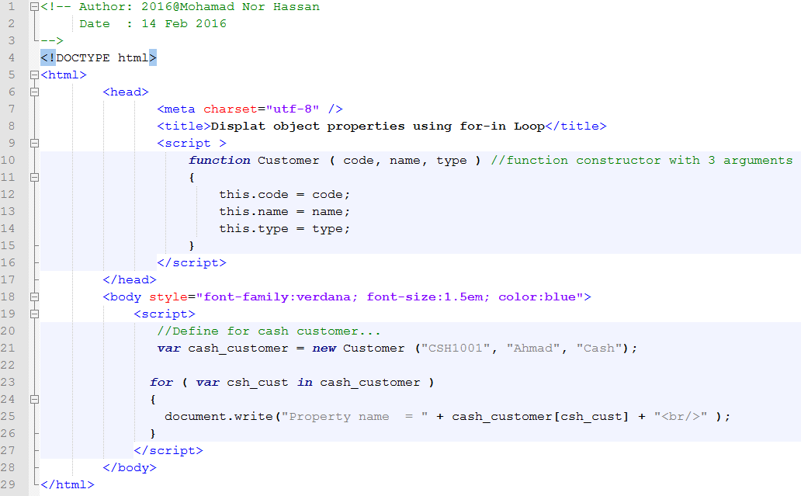
Display the Object properties using for-in Loop
Using for-in Loop

Slide 16
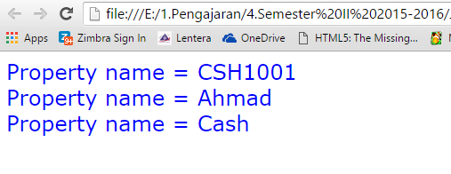
Output for Object properties using for-in Loop

Slide 17
JavaScript Objects
Everything we do in JavaScript – are based on an objects.
Object
Core Objects
User-Defined Objects

Slide 18
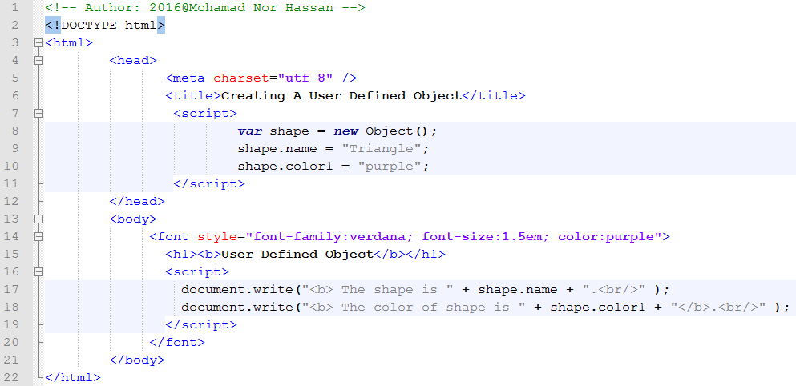
Example of Creating User-Defined Object
Create an instance of object

Slide 19
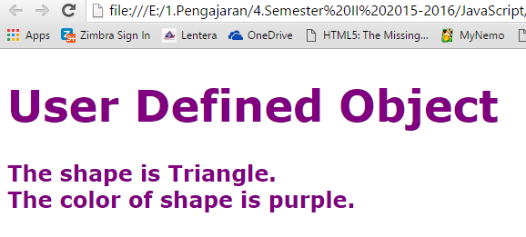
Output Creating of User-Defined Object

Slide 20
JavaScript Core Objects
Example of core objects:-
Date, String, Array, Math, Regular expressions, etc.

Slide 21
Main Focus on JavaScript Core Objects
Array
JavaScript Cores Objects
Date
Math

Slide 22
Array Objects
An array – a collection of data/records/values store as an elements.
An array is accessed with an index value.
Built-in object in JavaScripts
“A”
“C”
“B-”
“C+”
grade[0]
grade[1]
grade[2]
grade[3]
A numeric Array object known as grade.
index

Slide 23
Declaring and Populating Arrays
Syntax:
var array_name = new Array();
Example:
var grade = new Array();
grade[0] = “A”;
grade[1] = “C”;
grade[2] = “B-”;
grade[3] = “C+”;
You can defined the array size; eg.
var grade = new Array(10);
Alternative way to declare array?

Slide 24
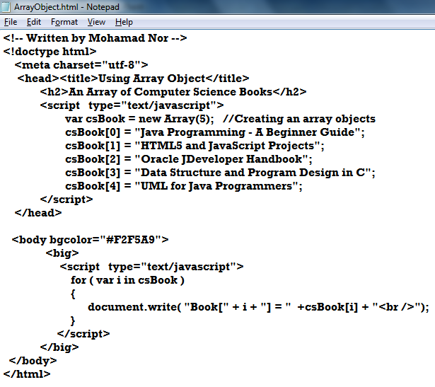
Example an Array Object
Instantiate an Array object
Print the values on array CSBook

Slide 25
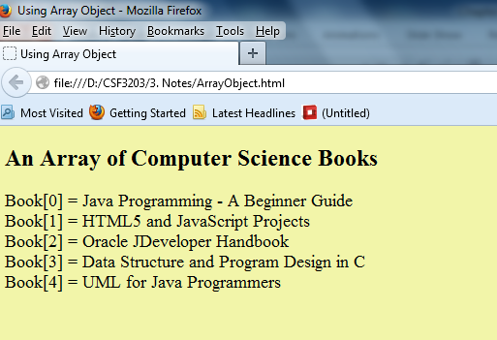
Output of an Array Object
Associate data with names
Note: JavaScript Array object can be implemented using an Associative Array.

Slide 26
Example of Associative Arrays
(Hashes)
var customers = new object();
customers[“John Doe”] = “123 Main St., Metropolis, USA”;
customers[“Jane Cheung”] = “123 Fake St., Vancouver B.C, Canada”;
customers[“Marie-France Lessard”] = “145 Longueil QC, Canada”;
for (var client in customers)
{
document.writeln(“The address of client “ + client + “ is:”);
document.writeln(customers[client]);
document.writeln(“<br><br>”);
}
Output?
The address of client John Doe is: 123 Main St., Metropolis, USA
The address of client Jane Cheung is: 123 Fake St., Vancouver B.C, Canada
The address of client Marie-France Lessard is: 145 Longueil QC, Canada

Slide 27
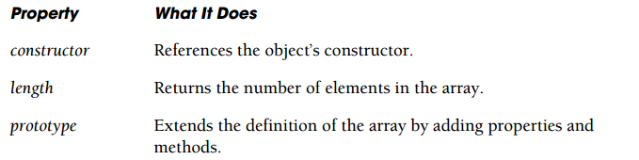
Array Object Properties
An array Object has 3 properties;
  constructor
  length
  prototype
Source: Quigley, E. (2012) – JavaScript by Example. Second Edition.

Slide 28
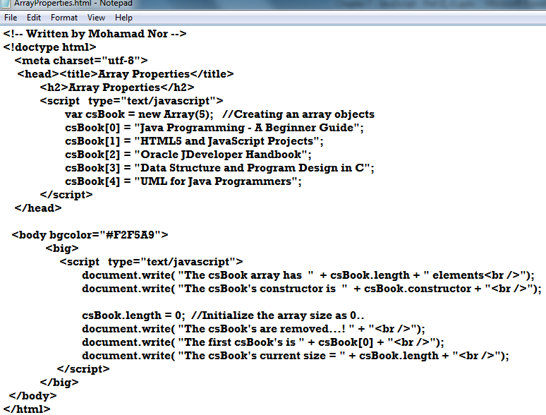
Example of Array Object Properties
Array Object Properties

Slide 29
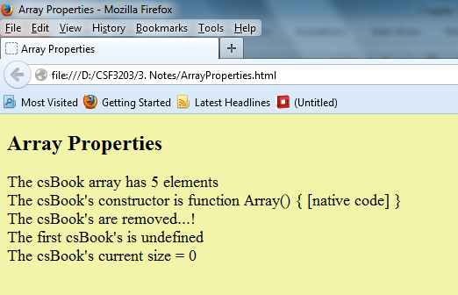
Output of an Array Object Properties

Slide 30
Two-Dimensional Array
Declaration:
  Using Array constructor
  var marking = new Array( new Array(50, 68, 65),
  new Array(78, 65, 70),
  new Array(88, 52, 62),
  );
  Using literal
  var marking = [ [50, 68, 65],
  [78, 65, 70],
  [88, 52, 62],
  ];

Slide 31
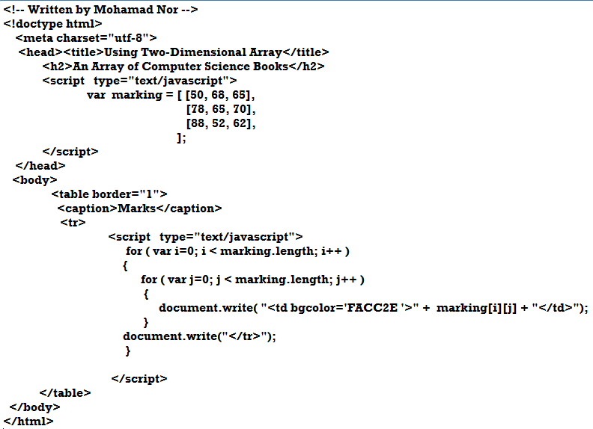
Example of Two-Dimensional Array

Slide 32
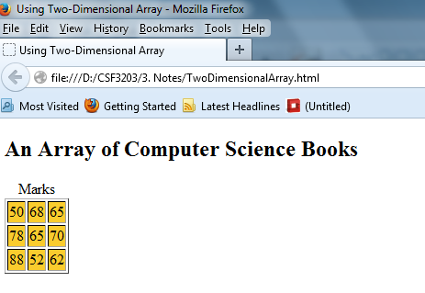
Output for Two-Dimensional Array

Slide 33
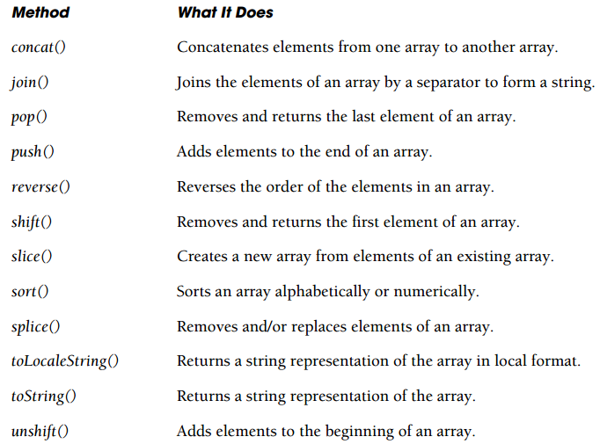
Array Methods
Source: Quigley, E. (2012) – JavaScript by Example. Second Edition.

Slide 34
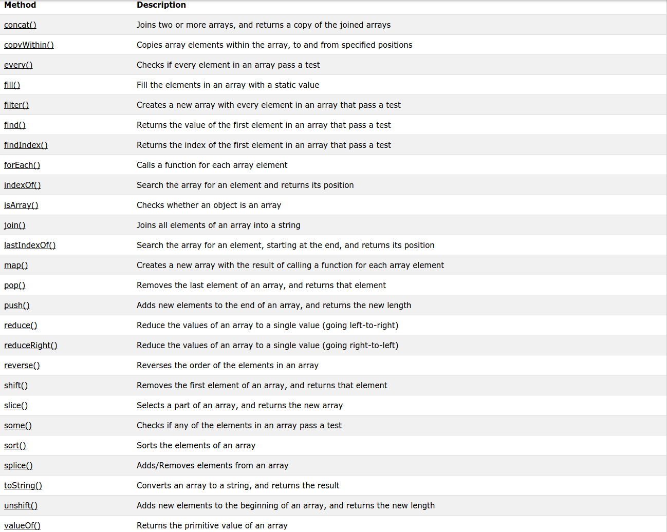

Slide 35
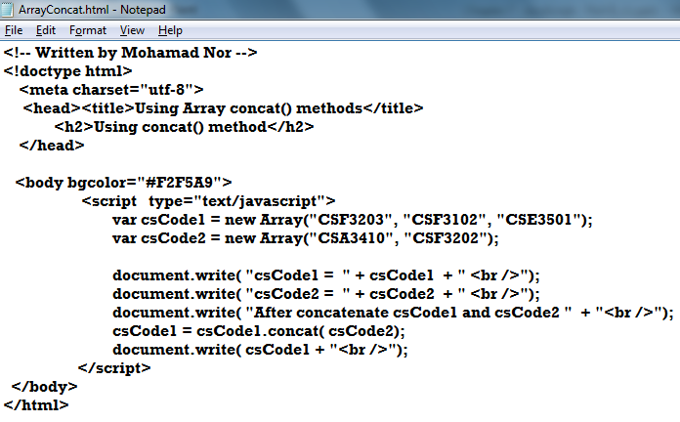
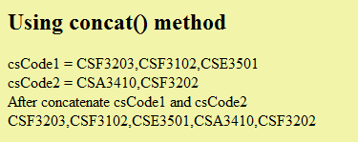
Example Using concat() Method

Slide 36
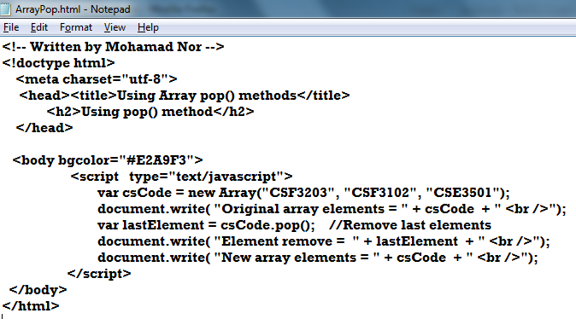
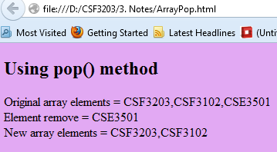
Example Using pop() Method

Slide 37
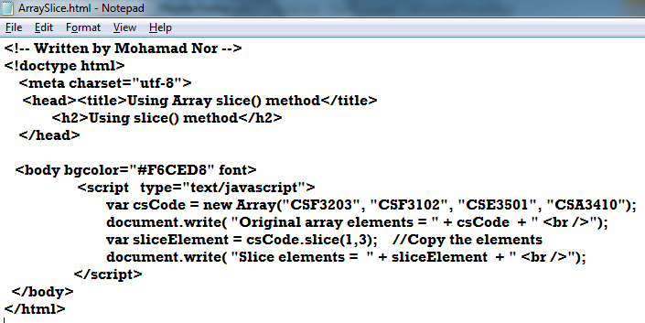
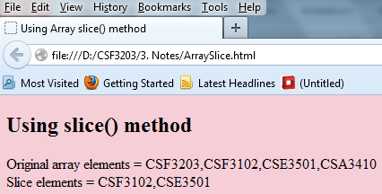
Example Using slice() Method

Slide 38
The Difference Between Arrays and Objects
In JavaScript, arrays use numbered indexes.
In JavaScript, objects use named indexes.
When to Use Arrays. When to use Objects.
You should use objects when you want the element names to be strings (text).
You should use arrays when you want the element names to be numbers.

Slide 39
Date Object
Provide several method to get and set specific information related to date and time.
Date & times return from Date’s object – based on local pc.
Instantiate Date’s objects:
  Format
  new Date();
  new Date(“Month dd, yyyy hh:mm:ss”);
  new Date(“Month dd, yyyy”);
  new Date(yy, mm, dd, hh,mm,ss);
  new Date(yy, mm, dd);
  E.g. var myDate = new Date();
  var myDate = new Date(“March 25, 2014 09:45:15”);
  var myDate = new Date(“March 25, 2014”);
  var myDate = new Date(14, 03, 25, 9,45,15);
  var myDate = new Date(14, 03, 25);
  var myDate = new Date(1000);
  var myDate = new Date(milliseconds);

Slide 40
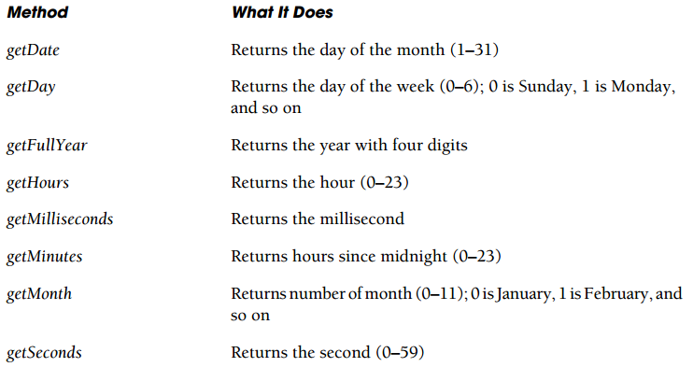
Date Object Methods
Source: Quigley, E. (2012) – JavaScript by Example. Second Edition.

Slide 41
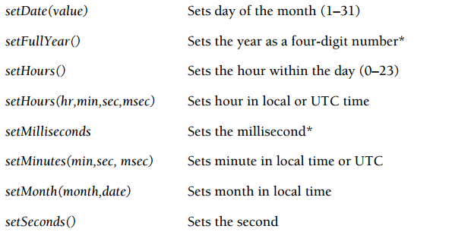
Date Object Methods
Source: Quigley, E. (2012) – JavaScript by Example. Second Edition.

Slide 42
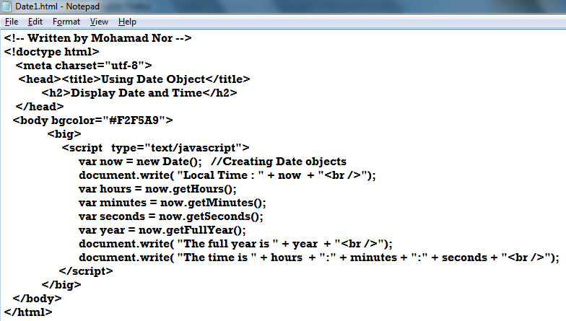
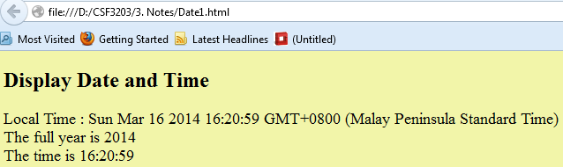
Example 1 – Using Date Object
Methods for Date object

Slide 43
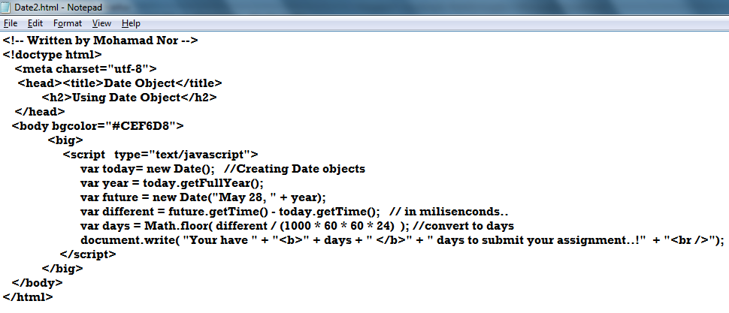
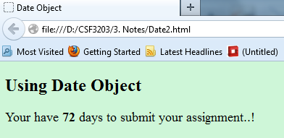
Example 2 – Manipulating Date Object

Slide 44
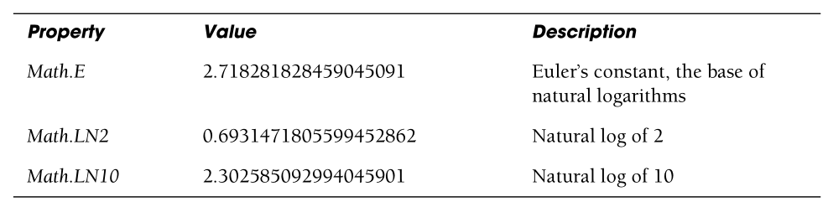
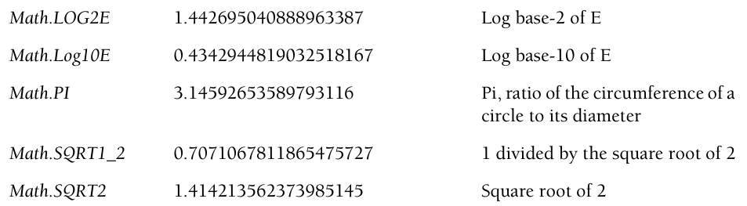
Maths Object
Allows developer to work with more advanced arithmetic calculations; square root, trigonometric functions, logarithms, and random numbers.
Source: Quigley, E. (2012) – JavaScript by Example. Second Edition.

Slide 45
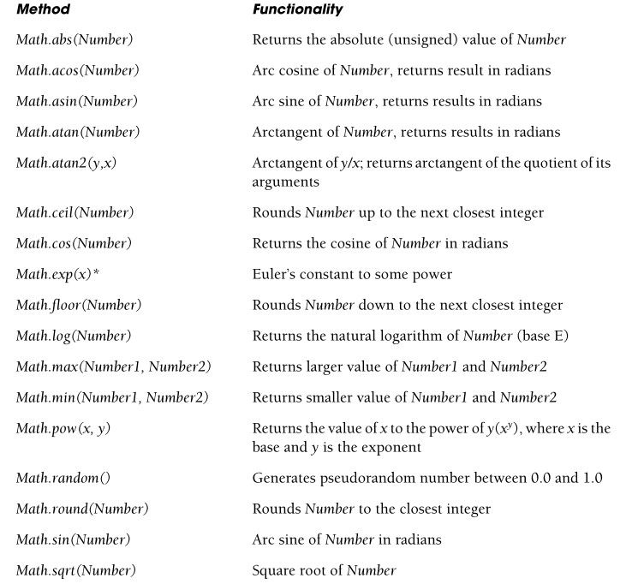
Math Methods
Source: Quigley, E. (2012) – JavaScript by Example. Second Edition.

Slide 46
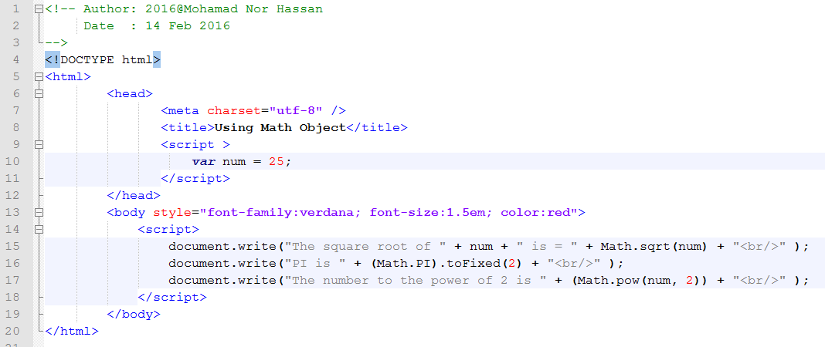
Example the use of Math Object

Slide 47
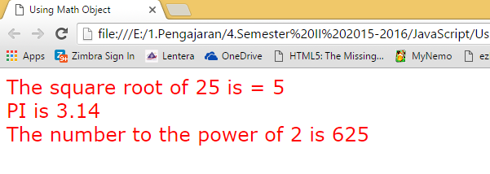
Output the use of Math Object

Slide 48
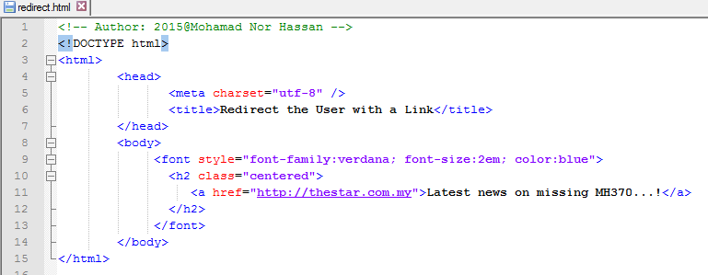
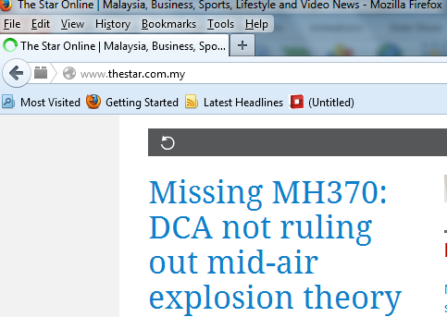
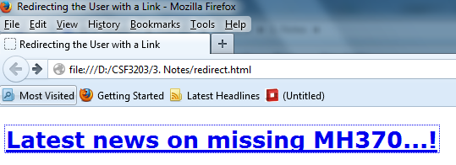
Redirect the user with a Link
2
1

Slide 49
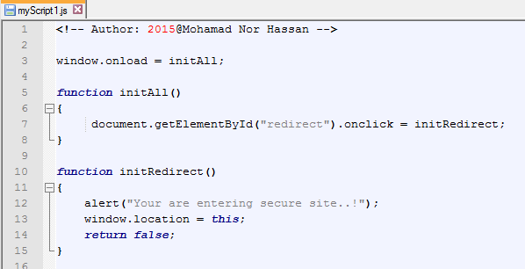
Redirect the user by include the redirection inside JavaScript
Step 1 – Create external JavaScript files –> myScript1.js
Retrieve HTML link element identifier…!

Slide 50
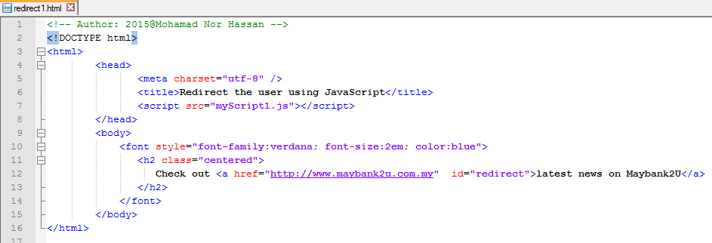
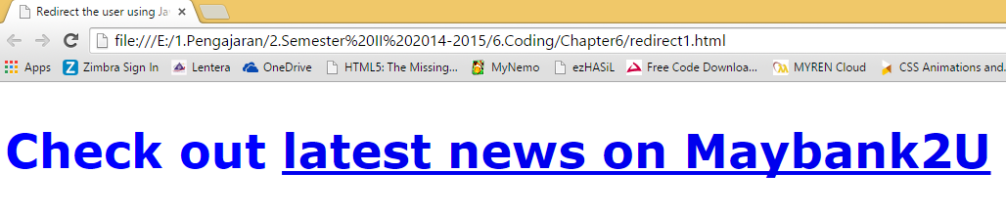
Redirect the user by include the redirection inside JavaScript
Step 2 – Create HTML file.
HTML link identifier
1

Slide 51
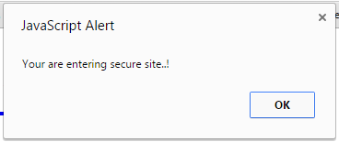

Redirect the user by include the redirection inside JavaScript
2
3

Slide 52
Reference
Quigley, E. (2012). JavaScript by Example. 2nd Edition. Michigan, USA. Prentice Hall.
Negrino, T. & Smith, D.(2012) – JavaScript Eight Edition. Berkeley, CA. Visual QuickStart Guide.
W3schools.com (2014). JavaScript Tutorial. http://www.w3schools.com/js/default.asp
Tutorialspoint – Simply Easy Learning (2014). Javascript Tutorial. http://www.tutorialspoint.com/javascript/index.htm

